Slide 1
7 x 7 Hybrid Median Filter, H. Dave
BME
7112
Original: Data File 4A.tif
Filtered Image:
SPRING
2019

Slide 2
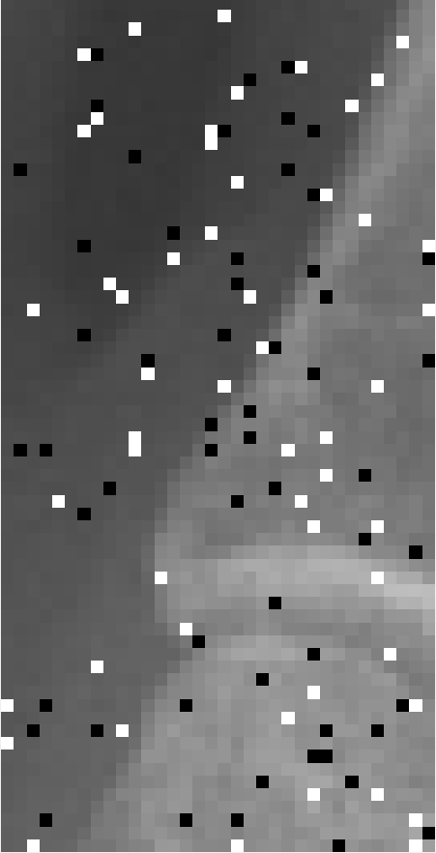
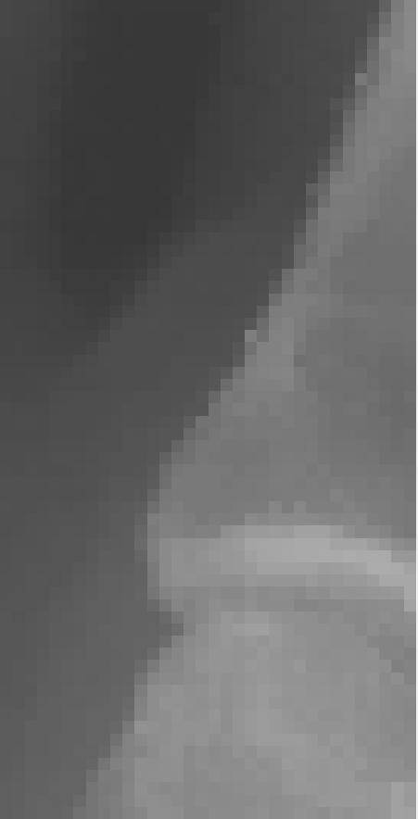
7 x 7 Hybrid Median Filter, H. Dave
Original: Data File 4A.tif
Filtered Image:
BME
7112
SPRING
2019

